Slide 1
Bridge Design Pattern
P-000

Slide 2
Bridge Design Pattern
Use the Bridge Pattern to vary not only your implementations, but also your abstractions.

Slide 3
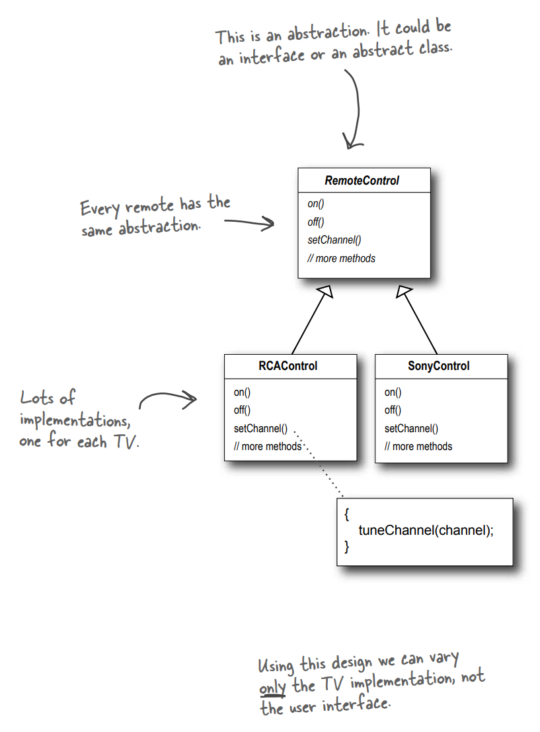
Use the Bridge Pattern to vary not only your implementations, but also your abstractions.

Slide 4
